Slide 1
Virtual Machine Scheduler
Team 14
NCGs
Neeraj Menon S
Vaibhav Pundir
Harita Chaudhari
Anamya Agarwal
Facilitator
BhanuKiran Karanam
Mentors
Harmanpreet Singh
Ayan Chakravorty
https://gitlab.eng.vmware.com/group-14-vm-scheduler/bootcamp_1

Slide 2
Outline
Language
Tools
Framework
UI – React.JS
Backend – Java
SQL
IntelliJ IDEA
Postman
DBeaver
Visual Studio Code
Vmware Clarity
Spring

Slide 3
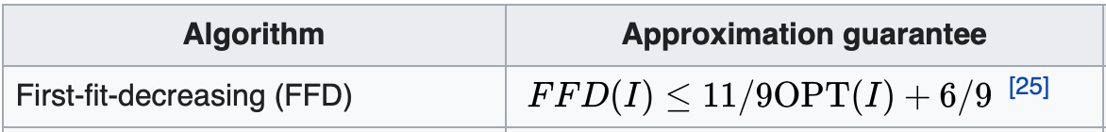





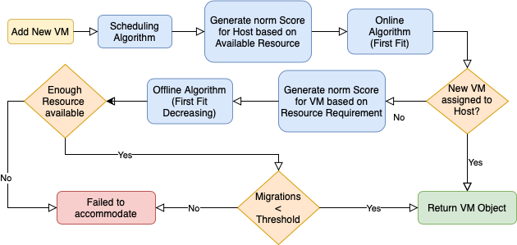
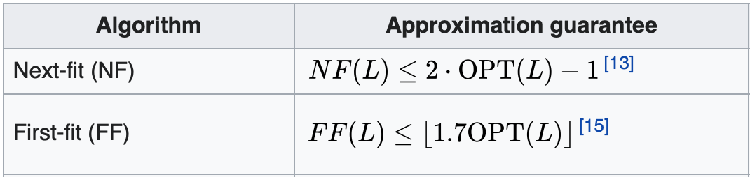



Solution Approach and Design
Identified the problem as Bin Packing Problem, where hosts are bin and VMs are items
2 approaches –
Online – First Fit Algorithm (FF)
Offline – First Fit Decreasing Algorithm (FFD)
Using min-max Normalization scheme to give score to each VM
Assuming hosts have 10 core capacity
Input Stream
9 -> 5 -> 2 -> 8 -> 4 -> 5 -> 6
Using First Fit
Using our Approach
Advantage – Lower number of hosts are required for the same VMs
https://gitlab.eng.vmware.com/group-14-vm-scheduler/bootcamp_1

Slide 4
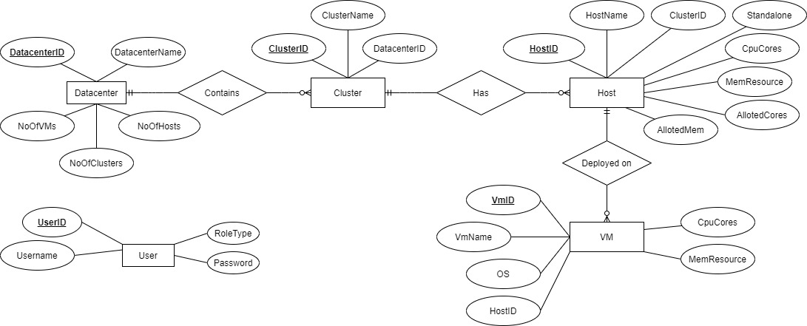
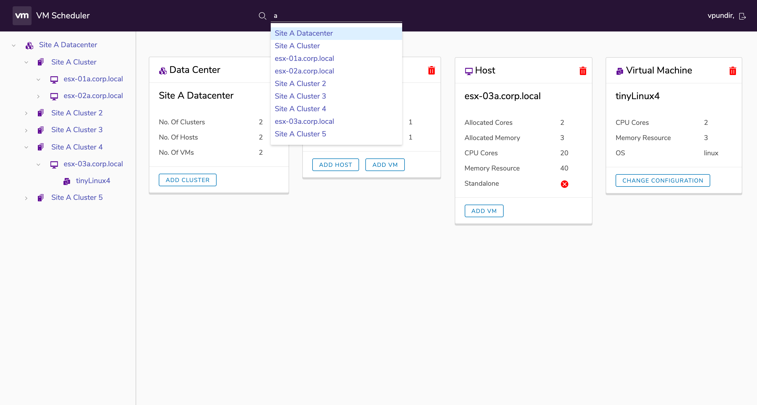
Features
v1
v2
v3
Objects (DataCenter, Cluster etc.) defined
ER Model
Scheduling Algo is designed with option to deploy VM on cluster and ESXi host
APIs are Implemented for all operations
UI Portal Designed
Rebalancing (Migration) of VMs between hosts in the cluster to accommodate new VM
Completed 30% Test coverage
Support for min-max VM requirement.
When the VM host is changed and the existing VM does not have enough resource then the algorithm will do migration to support the new VM requirement.
Algorithm supports adding Storage and Network parameters

Slide 5
Beyond the Scope
Migration Threshold is introduced, so that user can set the maximum allowed migrations while adding a new VM
Search support for searching Datacenter / Cluster / Host / Virtual Machine for ease of use.
Energy Aware VM Scheduling algorithm, makes use of minimum number of Hosts while scheduling
Relevant error messages and codes are displayed like ”Resource Not available” for the new VM
For protecting the password of the user we use SHA – 256 and implemented spring boot with bcrypt
https://gitlab.eng.vmware.com/group-14-vm-scheduler/bootcamp_1

